Slide 1
Surface area of cylinders
Perimeter, area and volume

Slide 2
how to use Oak lessons

Slide 3
I can find the surface area of cylinders.

Slide 4
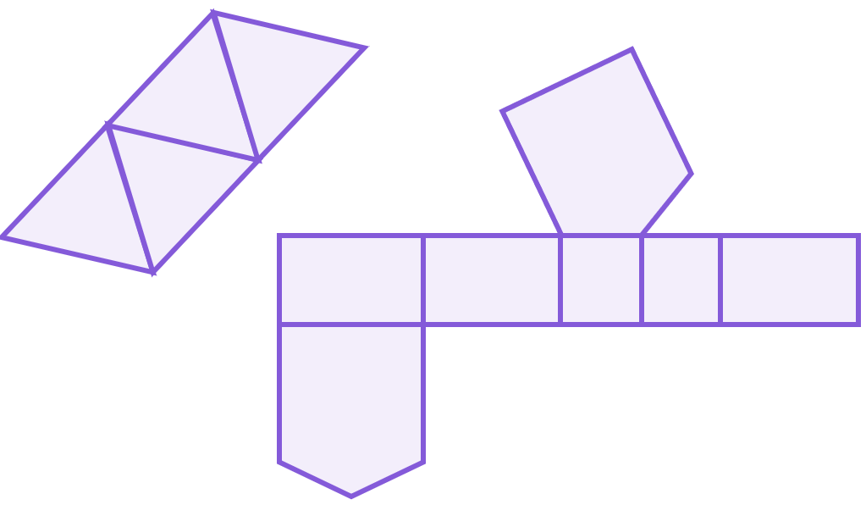
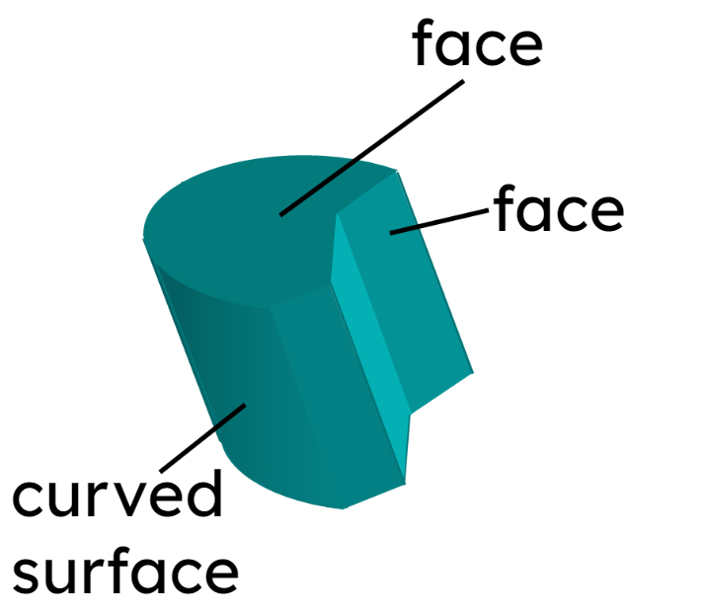
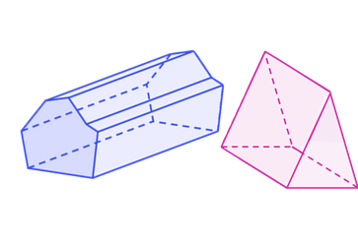
The net of a 3D object is a 2D representation of its surfaces that can be folded up into the 3D object.
Faces are the flat 2D surfaces of a 3D shape.
A prism is a polyhedron with a base that is a polygon and a parallel opposite face that is identical. The corresponding edges of the two polygons are joined by parallelograms.
The surface area is the total area of all the surfaces of a closed 3D shape. The surfaces include all faces and any curved surfaces.

Slide 5
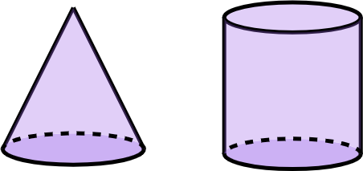
A cylinder is a 3D shape with a base that is a circle and a parallel opposite face that is identical. A cross section of a cylinder made parallel to the base will be congruent to the base.

Slide 6

Surface area of cylinders
Finding the surface area of a cylinder
Using the surface area of a cylinder

Slide 7
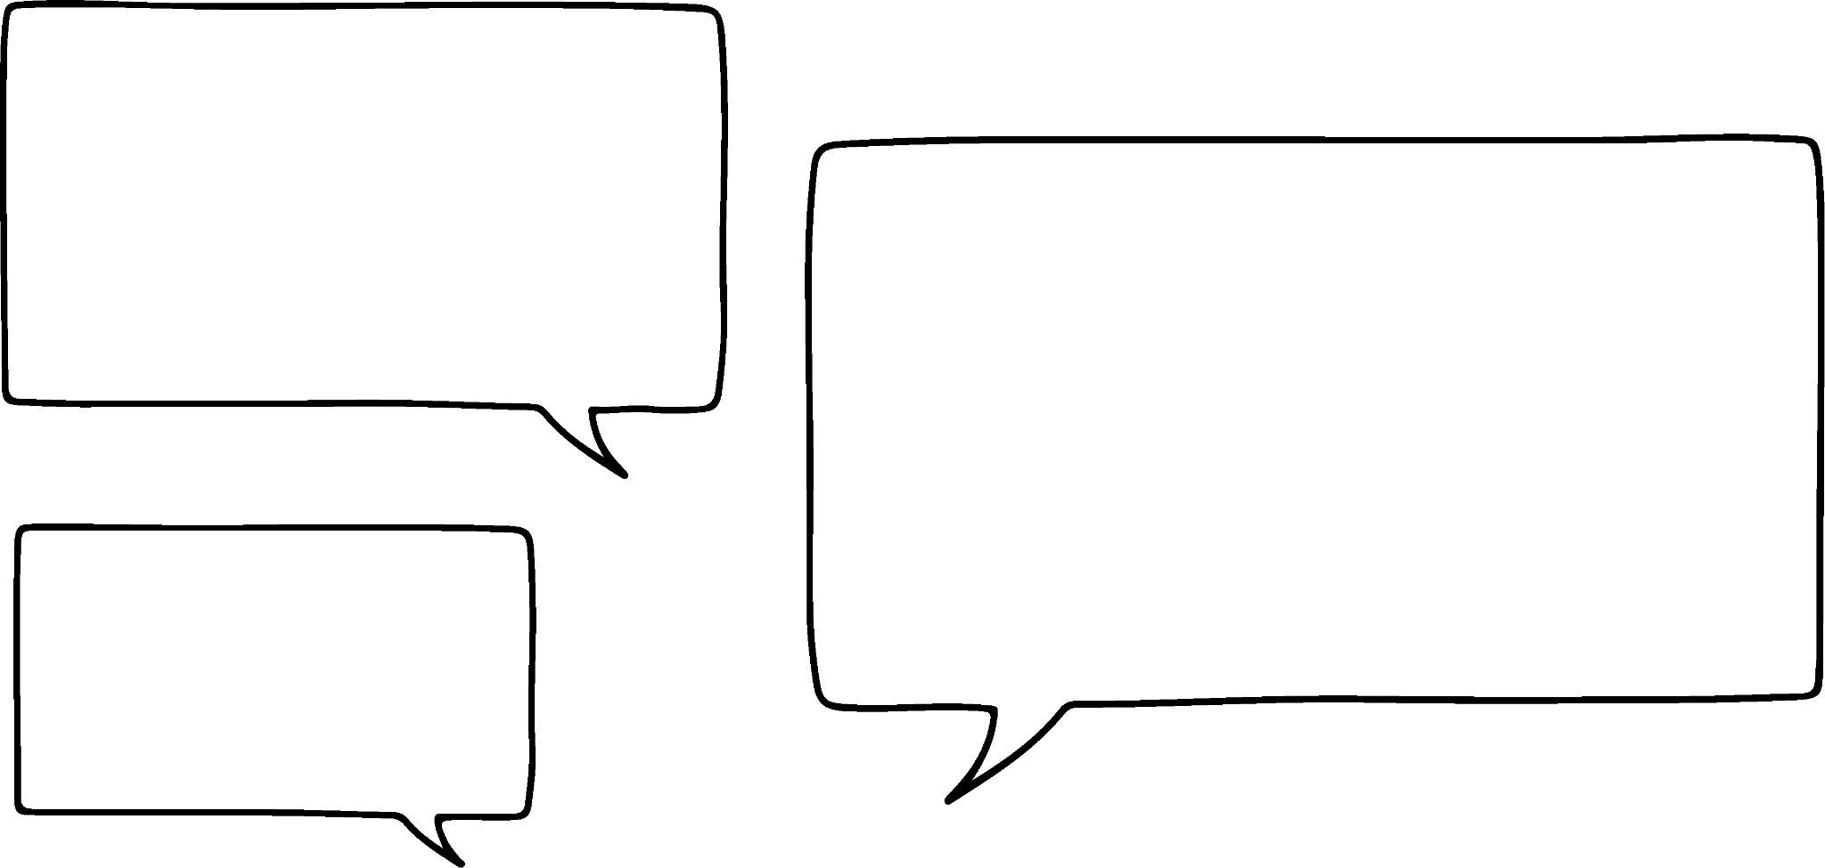


Finding the surface area of a cylinder
What is a cylinder?
A cylinder is a 3D shape.
A cylinder has a circular face.
Izzy
Jacob
Both of these solids meet Jacob and Izzy’s descriptions. One of them is a cone and the other is the cylinder.
cone
cylinder

Slide 8

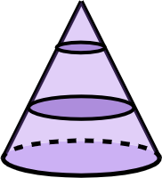
Finding the surface area of a cylinder
What is a cylinder?
The cylinder has a uniform cross-section all the way through, whereas the cone changes size.

Slide 9


Finding the surface area of a cylinder
A right prism is a polyhedron with a base that is a polygon and a parallel opposite face that is identical. The corresponding edges of the two polygons are joined by rectangles.
So a cylinder is a prism!
A circle is not a polygon!
Sofia
Alex

Slide 10
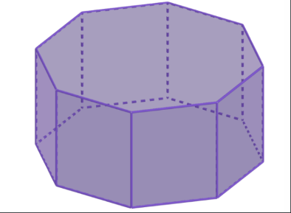
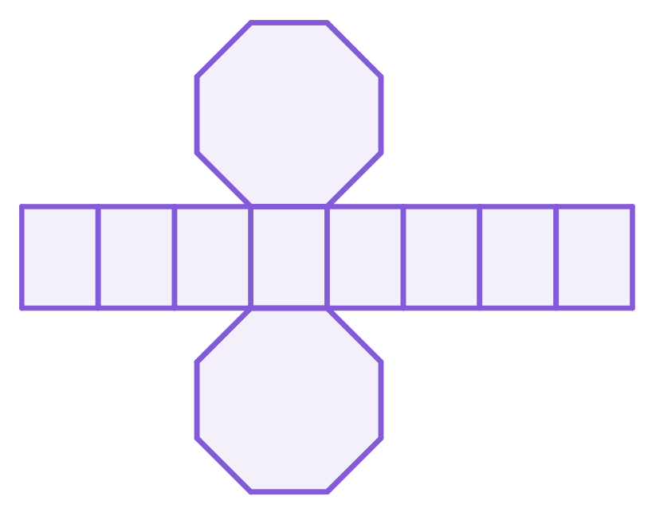
Finding the surface area of a cylinder
Solid
Net
This is a regular octagonal prism.

Slide 11
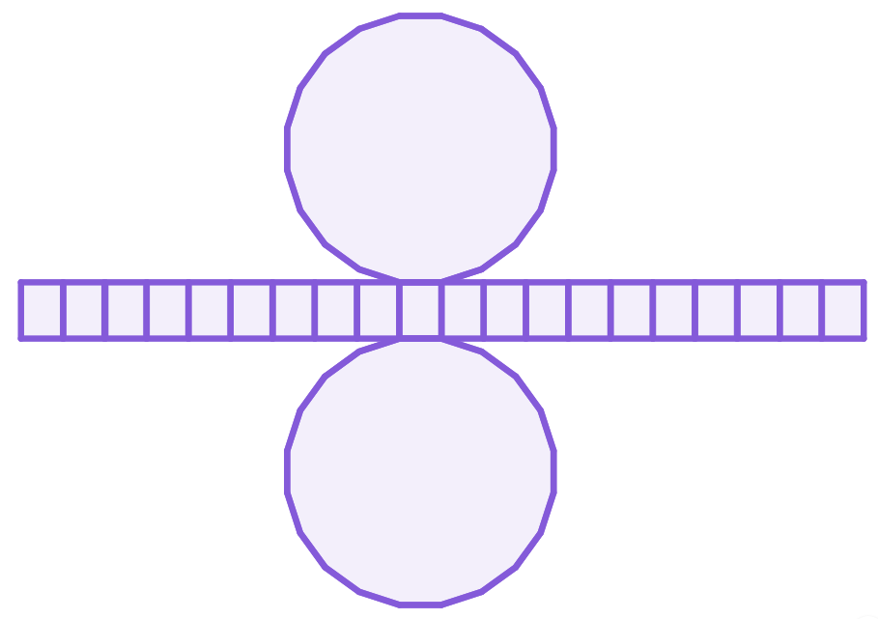
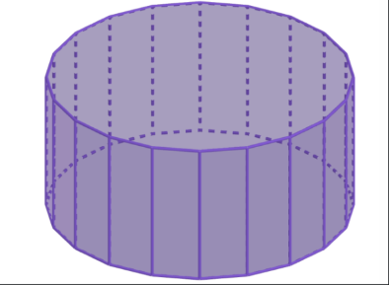
Finding the surface area of a cylinder
Solid
Net
This is a regular 20-sided prism.

Slide 12
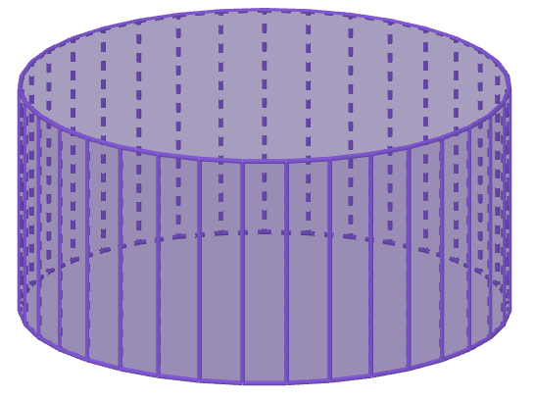
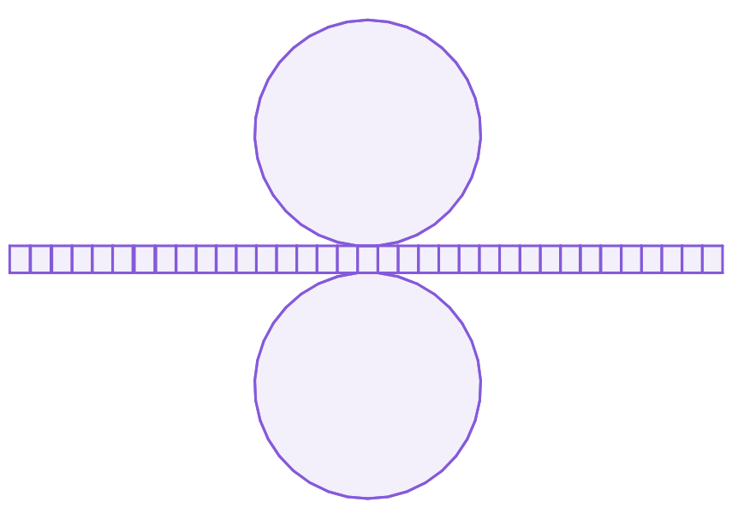
Finding the surface area of a cylinder
Solid
Net
This is a regular 35-sided prism.

Slide 13

Finding the surface area of a cylinder
As the number of edges increases, will it ever become a cylinder?
It has started to look more like a circular face, but does that mean it will become a circle?
Surely there will be an angle between the edges of the many-sided polygon? If you zoom in far enough.
Laura
Izzy
Let’s see…
Jacob

Slide 14
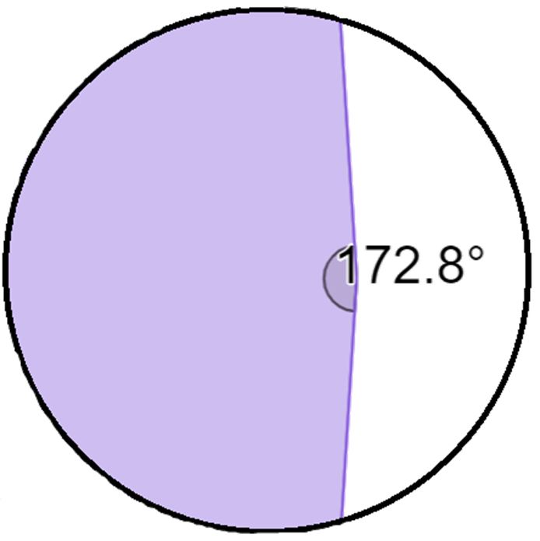

Finding the surface area of a cylinder
50-sided polygon
There is a large obtuse angle between two of the 50 edges.

Slide 15
Finding the surface area of a cylinder
If the number of sides increased to more than 50, there would still be edges and an angle would still be created between the edges.
But it helps us to know what the net of a cylinder might look like.
This is why a cylinder is not a prism, because the base face is not a polygon.
Izzy
Laura
Jacob

Slide 16
Finding the surface area of a cylinder
An unfolded cylinder would look like this:
circular face ends
curved face

Slide 17
Finding the surface area of a cylinder
The curved face is rectangular when laid flat.
The length of the rectangle is the perimeter of the circle; the circumference.
The width of the rectangle would be the length/height/depth of the cylinder.

Slide 18
Finding the surface area of a cylinder
Surface area of a cylinder
= 2 ✕ circle area + rectangle area
= 2 ✕ 𝜋r² + (circumference ✕ height)
= 2𝜋r² + (2𝜋r ✕ height)
= 2𝜋r² + 2𝜋rh
circumference
area of a circle

Slide 19

Finding the surface area of a cylinder
The surface area of any cylinder = 2𝜋r² + 2𝜋rh, where r is the radius and h is the height. r and h are …
the 2𝜋 in both terms are constants
constants.
variables.
2𝜋r² and 2𝜋rh are both terms
terms.

Slide 20
Finding the surface area of a cylinder
Find the surface area of this cylinder.
3 cm
3 cm
4 cm
2 × π × 3
4 cm
Surface area = 2 × π × 3² + 4 × π × 6
= 18π + 24π
= 42π cm²

Slide 21


Finding the surface area of a cylinder
Surface area of a cylinder = 2𝜋r² + 2𝜋rh
That is equivalent to 2𝜋r(r + h)
It is also equivalent to 2𝜋r² + 𝜋dh
Aisha
Lucas

Slide 22
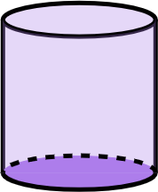
Finding the surface area of a cylinder
Surface area of a cylinder ≡ 2𝜋r² + 2𝜋rh ≡ 2𝜋r(r + h) ≡ 2𝜋r² + 𝜋dh
Surface area
= 2 × 𝝅 × 3 × (3 + 5) = 48𝝅 mm²
Surface area
= 2 × 𝝅 × 3² + 𝝅 × 6 × 5
= 18𝝅 + 30𝝅 = 48𝝅 mm²
r = 3 mm
Lucas
Aisha
h = 5 mm

Slide 23
Finding the surface area of a cylinder
You have to use a certain formula depending on whether you have the diameter or radius of the circle.
The radius and diameter of a circle have a multiplicative relationship so you can use any of the variations of formula
If you know the radius, use a formula with r. If you know the diameter, use the formula with d

Slide 24
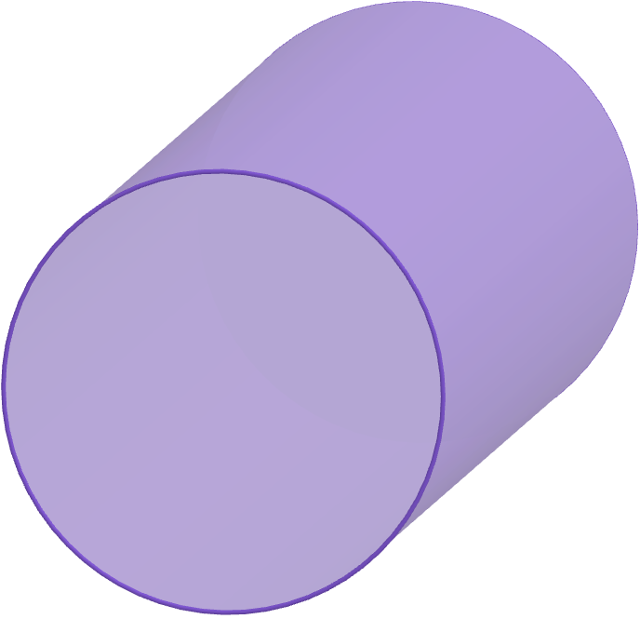
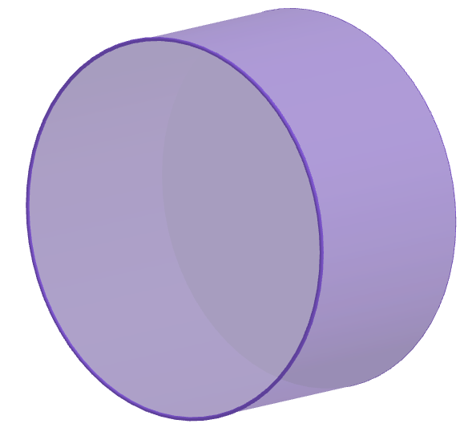
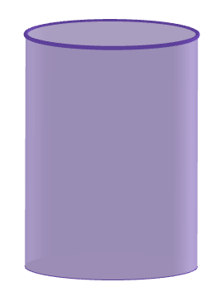
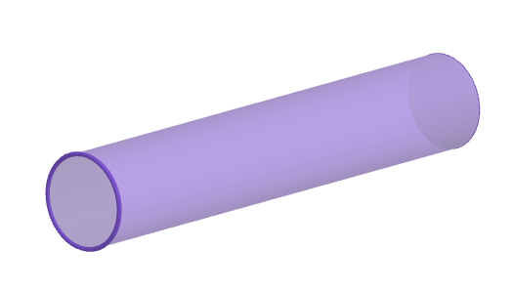
Finding the surface area of a cylinder
1) Work out the surface area of the following cylinders.
a)
b)
c)
4 cm
4 cm
138 mm
11 cm
3 cm
37 mm
d)
90 cm
5 m

Slide 25


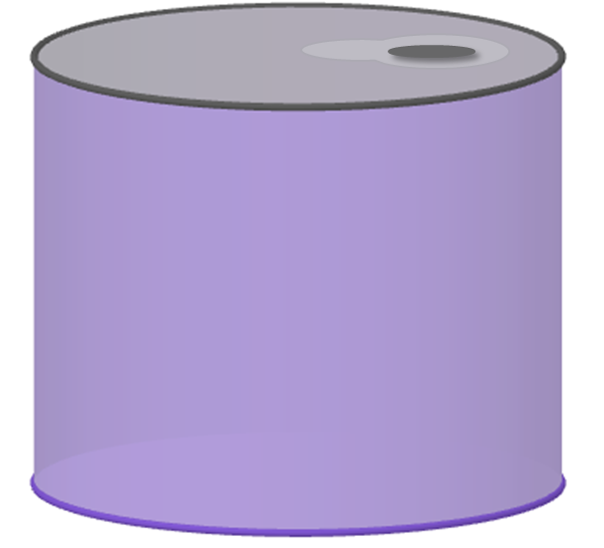
Finding the surface area of a cylinder
2) A drinks company are looking to use less material when making their cans. These two cans both hold 330 ml of liquid. Which can should the drinks company choose?
40 mm
a
109 mm
66 mm
b
62 mm

Slide 26
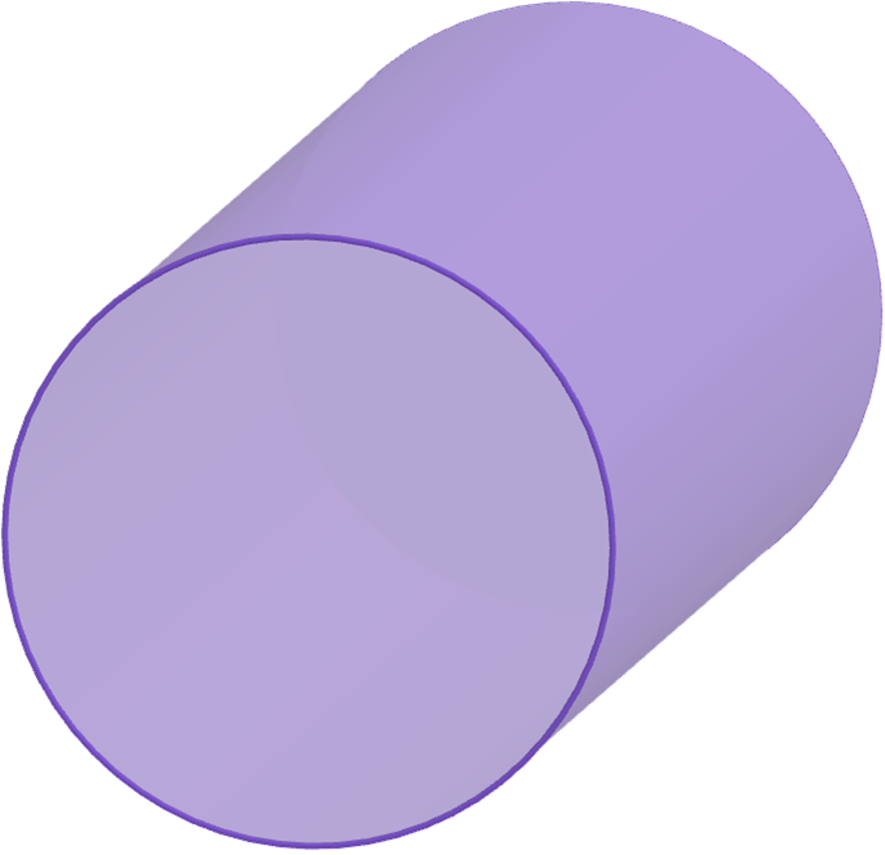
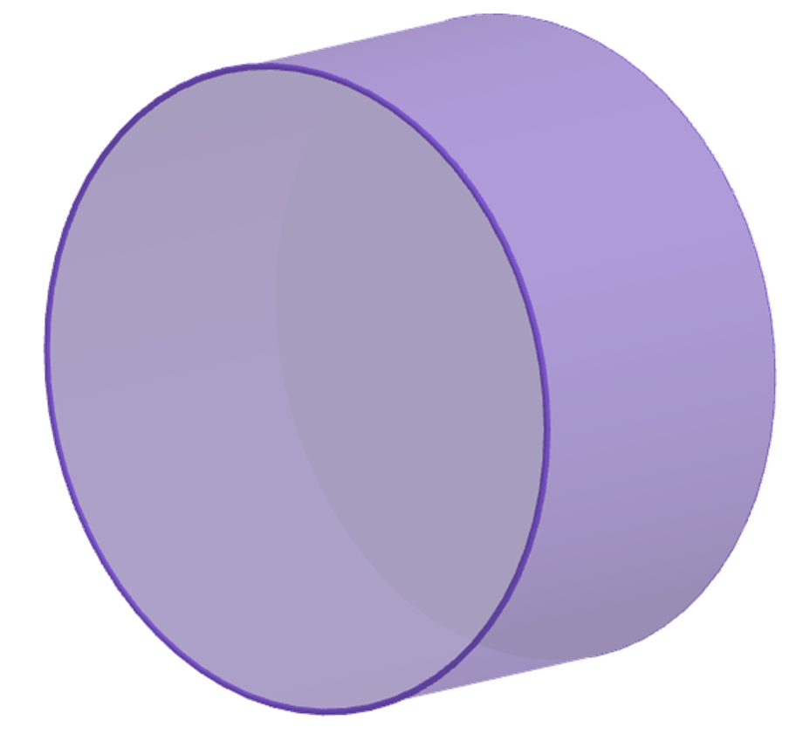
Finding the surface area of a cylinder
1) Work out the surface area of the following cylinders.
a)
b)
4 cm
4 cm
11 cm
3 cm
Surface area
= 2 × 𝜋 × 4² + 2 × 𝜋 × 4 × 11
= 32𝜋 + 88𝜋
= 120𝜋 = 377.0 cm² (1 d.p.)
Surface area
= 2 × 𝜋 × 2² + 𝜋 × 4 × 3
= 8𝜋 + 12𝜋
= 20𝜋 = 62.8 cm² (1 d.p.)

Slide 27
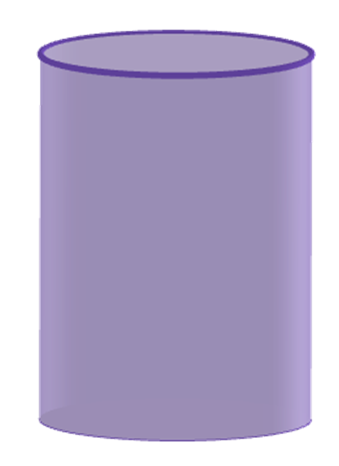
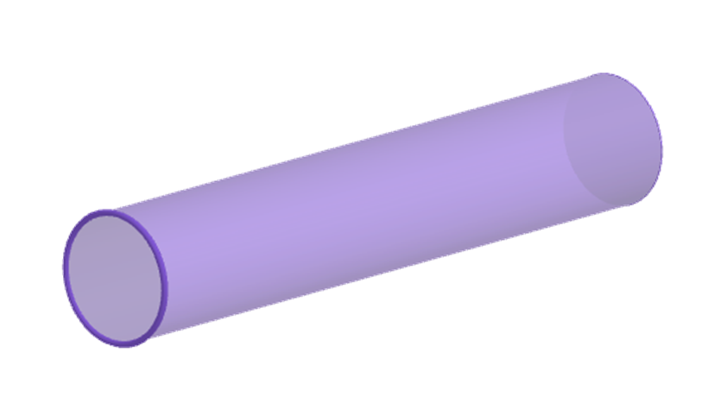
Finding the surface area of a cylinder
1) Work out the surface area of the following cylinders.
c)
d)
90 cm
138 mm
5 m
37 mm
Surface area
= 2 × 𝜋 × 37² + 2 × 𝜋 × 37 × 138
= 2738𝜋 + 10212𝜋
= 12950𝜋 = 40 683.6 mm² (1 d.p.)
Surface area
= 2 × 𝜋 × 0.45² + 𝜋 × 0.9 × 5
= 0.405𝜋 + 4.5𝜋
= 4.905𝜋 = 15.4 m² (1 d.p.)

Slide 28

Finding the surface area of a cylinder
2) A drinks company are looking to use less material when making their cans. These two cans both hold 330 ml of liquid. Which can should the drinks company choose?
Surface area
= 2 × 𝜋 × 31² + 𝜋 × 62 × 109
= 1922𝜋 + 6758𝜋
= 8680𝜋 = 27 269.0 mm² (1 d.p.)
a
109 mm
62 mm

Slide 29
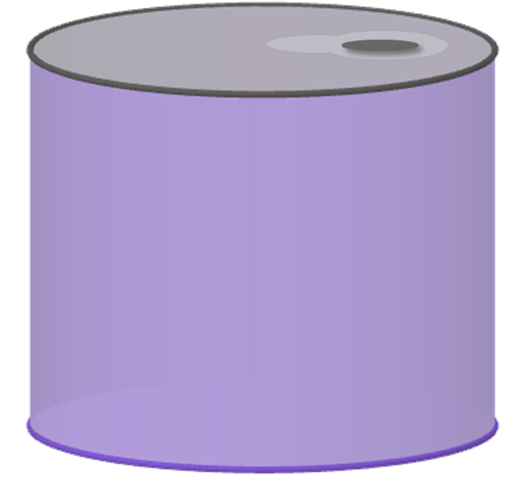
Finding the surface area of a cylinder
2) A drinks company are looking to use less material when making their cans. These two cans both hold 330 ml of liquid. Which can should the drinks company choose?
40 mm
Surface area
= 2 × 𝜋 × 40² + 2 × 𝜋 × 40 × 66
= 3200𝜋 + 5280𝜋
= 8480𝜋 = 26 640.7 mm² (1 d.p.)
66 mm
b

Slide 30
Finding the surface area of a cylinder
2) A drinks company are looking to use less material when making their cans. These two cans both hold 330 ml of liquid. Which can should the drinks company choose?
The drinks company should choose can b.
Surface area
= 8680𝜋
Surface area
= 8480𝜋
40 mm
a
109 mm
66 mm
b
62 mm

Slide 31
Surface area of cylinders
Finding the surface area of a cylinder
Using the surface area of a cylinder

Slide 32

Using the surface area of a cylinder
The surface area of any cylinder = 2𝜋r² + 2𝜋rh, where r is the radius and h is the height.
The formula involves three variables:
surface area
radius
height
This means if the radius was to change, the surface area would too.
The surface area is dependent on the radius and height of the cylinder.
Andeep
🖇Surface area of a cylinder

Slide 33
Using the surface area of a cylinder
The surface area of any cylinder = 2𝜋r² + 2𝜋rh, where r is the radius and h is the height.
The formula involves three variables:
surface area
radius
height
Similarly, if the height was to change, the surface area would change.
The surface area is dependent on the radius and height of the cylinder.
Andeep
🖇Surface area of a cylinder

Slide 34
Using the surface area of a cylinder
The surface area of any cylinder = 2𝜋r² + 2𝜋rh, where r is the radius and h is the height.
But the radius and height are not necessarily dependent on each other.
The formula involves three variables:
surface area
radius
height
The surface area is dependent on the radius and height of the cylinder.
Andeep
🖇Surface area of a cylinder

Slide 35
Using the surface area of a cylinder
Fill the blanks.
The surface area is dependent on the and the
of the cylinder.
If the radius changes, the will change too.
height
radius
surface area

Slide 36

Using the surface area of a cylinder
A small cheese making company needs to wax a cheese truckle. They have enough wax to cover an area of 1120𝜋 cm². The cheese truckle has a radius of 14 cm. How high can the cheese truckle be?
14 cm
h cm
What information do we have?
surface area = 1120𝜋 cm²
radius = 14 cm
1120𝜋 = 2 × 𝜋 × 14² + 2 × 𝜋 × 14 × h
1120𝜋 = 392𝜋 + 28𝜋 × h
728𝜋 = 28𝜋 × h
26 = h
The cheese truckle can be 26 cm high.

Slide 37
Using the surface area of a cylinder
A cylinder has a surface area of 350𝜋 cm² and a diameter of 10 cm. What is the height of the cylinder?
A cylinder has a surface area of 90𝜋 cm² and a diameter of 6 cm. What is the length of the cylinder?
2 × 𝜋 × 5² + 2 × 𝜋 × 5 × h = 350𝜋
2 × 𝜋 × 3² + 2 × 𝜋 × 3 × h = 90𝜋
50𝜋 + 10𝜋h = 350𝜋
18𝜋 + 6𝜋h = 90𝜋
10𝜋h = 300𝜋
6𝜋h = 72𝜋
h = 30 cm
h = 12 cm

Slide 38
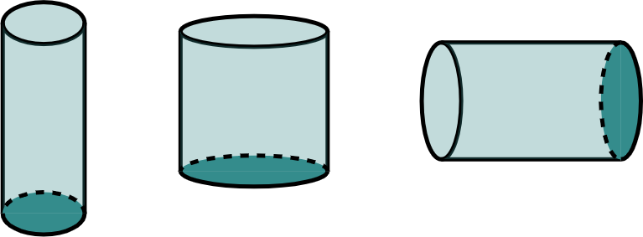
Using the surface area of a cylinder
1) Find the missing length in each question. Give your answers in cm.
3 cm
12 cm
c cm
a cm
b cm
80 mm
Surface area
= 88𝜋 cm²
Surface area
= 168𝜋 cm²
Surface area
= 78𝜋 cm²

Slide 39
Using the surface area of a cylinder
2) A necklace is being made. Part of the design is a metal cylindrical rod.
The rod is gold-plated. 208𝜋 mm² of gold leaf is used. The rod has a diameter of 4 mm.
How long is the rod?

Slide 40
Using the surface area of a cylinder
1) Find the missing length in each question. Give your answer in cm.
3 cm
2 × 𝜋 × 3² + 2 × 𝜋 × 3 × a = 78𝜋
18𝜋 + 6𝜋a = 78𝜋
a cm
6𝜋a = 60𝜋
a = 10 cm
Surface area
= 78𝜋 cm²

Slide 41
Using the surface area of a cylinder
1) Find the missing length in each question. Give your answer in cm.
12 cm
2 × 𝜋 × 6² + 2 × 𝜋 × 6 × b = 168𝜋
72𝜋 + 12𝜋b = 168𝜋
b cm
12𝜋b = 96𝜋
b = 8 cm
Surface area
= 168𝜋 cm²

Slide 42
Using the surface area of a cylinder
1) Find the missing length in each question. Give your answer in cm.
c cm
2 × 𝜋 × 4² + 2 × 𝜋 × 4 × c = 88𝜋
32𝜋 + 8𝜋c = 88𝜋
80 mm
8𝜋c = 56𝜋
c = 7 cm
Surface area
= 88𝜋 cm²

Slide 43
Using the surface area of a cylinder
2) A necklace is being made. Part of the design is a metal cylindrical rod.
The rod is gold-plated. 208𝜋 mm² of gold leaf is used. The rod has a diameter of 4 mm.
How long is the rod?
2 × 𝜋 × 2² + 2 × 𝜋 × 2 × l = 208𝜋
8𝜋 + 4𝜋l = 208𝜋
4𝜋l = 200𝜋
l = 50 mm

Slide 44
Surface area of cylinders
All cylinders have a circular cross-section so a formula can be derived for the surface area.
Surface area of a cylinder = 2𝜋r² + 2𝜋rh, where r is the radius and h is the height.
If the surface area is known, other lengths can be found.

Slide 45

© Oak National Academy 2023.
Produced in partnership with Mathematics in Education and Industry.
Licensed on the Open Government Licence v3.0, except where otherwise stated. See Oak terms and conditions.

